Slide 1
CS3383
Systematic Program Debugging
Week 7 Lecture

Slide 2
Distinguishing Failures from Bugs
A failure is an incorrect output of a program.
  E.g., in JUnit, we may use the API call AssertEqual() to determine whether or not the test case fails.
A bug (or fault) is an incorrect implementation (coding) that causes the program to produce failures.

Slide 3
How to Debug?
1. Locate Bug
2. Repair Program
3. Retest Program
We use three steps in a row for this purpose:

Slide 4
A model of program execution
A program P is a set of statements (code fragments) and a set of variables.
  Each variable keeps a value.
  Each statement may read a value from one or more variables and/or write a value to a variable.
  Outputting a value from a program means to write a value to a (system-specific) variable.
A program state is a set of tuples, each of which contains a variable v and the value of the variable v.
An execution trace is a sequence of executed statements.
  Note that the same program statement may occur in the same trace multiple time (and so we have 1st occurrence, 2nd occurrence, etc.)
  Thus, by walking through the statements in an execution trace σ from start to end and one by one, the program state of the execution trace σ is updated while we walk through the trace.

Slide 5
A model of program execution
Failure and Bug
A Failure
  A failure of a program P is an incorrect program output of an execution trace σ of the program P.
  We mark the statements that produce the failure on the trace σ
A Run
  A failed run refers to an execution trace that has marked with failure(s).
  A passed run refers to an execution trace that has not marked with any failure.
A Bug
  A bug (also known as a fault) is a mistake appearing in a program P.

Slide 6
A model of program execution
Impacts and Propagation from Bug to Failure
  To observe a failure from a run, a bug should propagate (carry along) its error along the trace from a buggy statement (say at position σ[b]) to the statement outputting a failure (say at position σ[f]).
  The buggy statement σ[b] transforms a correct program state before executing this buggy statement into an infected program state E_{b}.
  The difference between the correct (expected) program state and an infected program state is called an error.
  From an infected program state E_{b} onward, following sequence of statements (at positions σ[b+1], σ[b+2], …., σ[f]) in the trace σ will further transform E_{b} into a sequence of infected program states E_{1,} E_{2,} …., E_{f} . When the statement at the position σ[f] is executed, the corresponding error in the infected program state E_{f} will be observed as a failure of the execution trace σ.

Slide 7
Example: Relating Execution Information to Program States
1. int foo (int a, int b)
2. {
3. POINT pA = null; // bug
4. …
5. for () {
6. POINT pB = pA;
7. …
8. if () {
9. pB[3] = 0;
10. …
11. }
12. }
13. }
A pointer assigned to NULL
Another assignment NullPointer Error
A problematic memory access

Slide 8
Program State
The values of variables
Program states
1. int foo (int a, int b)
2. {
3. POINT pA = null; // bug
4. …
5. for () {
6. POINT pB = pA;
7. …
8. if () {
9. pB[3] = 0;
10. …
11. }
12. }
13. }

Slide 9
Program State
The values of variables
Program states
→ | Start | pA : N\A | pB : N\A | …
1. int foo (int a, int b)
2. {
3. POINT pA = null; // bug
4. …
5. for () {
6. POINT pB = pA;
7. …
8. if () {
9. pB[3] = 0;
10. …
11. }
12. }
13. }
N\A = undefined

Slide 10
Program States
Infected: It means the value of a variable is not correct.
Program states
→ → | Start | pA : N\A | pB : N\A | …
 | Line 3 | pA : null | pB : N\A | …
1. int foo (int a, int b)
2. {
3. POINT pA = null; // bug
4. …
5. for () {
6. POINT pB = pA;
7. …
8. if () {
9. pB[3] = 0;
10. …
11. }
12. }
13. }
infect

Slide 11
Program States
Program states
→ → → | Start | pA : N\A | pB : N\A | …
 | Line 3 | pA : null | pB : N\A | …
 | Line 6 | pA : null | pB : null | …
1. int foo (int a, int b)
2. {
3. POINT pA = null; // bug
4. …
5. for () {
6. POINT pB = pA;
7. …
8. if () {
9. pB[3] = 0;
10. …
11. }
12. }
13. }
infect
Note that the infected program state
has prorogated along the execution.

Slide 12
Program States
Program states
→ → → | Start | pA : N\A | pB : N\A | …
 | Line 3 | pA : null | pB : N\A | …
 | Line 6 | pA : null | pB : null | …
 | Line 9 | pA : null | pB : null | …
1. int foo (int a, int b)
2. {
3. POINT pA = null; // bug
4. …
5. for () {
6. POINT pB = pA;
7. …
8. if () {
9. pB[3] = 0;
10. …
11. }
12. }
13. }
crash
Null Pointer reference!
A program crash is the result.

Slide 13

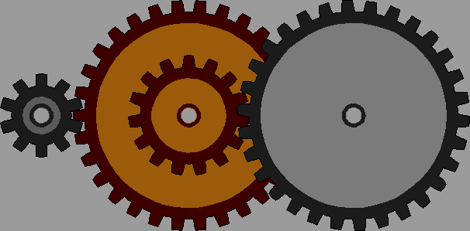



From Bug to Failure
Our Debugging Objective:: We want to break the chain so that a bug will not cause the program to produce a wrong output.
A programmer creates a bug
When executed, the fault creates an infection [感染] (an error in the program state) (e.g., ✘)
The infection propagates to make the following statements to compute wrongly.
The infection causes a failure ♣ at the program output.
input
✘
e.g., a bug at a statement
✘
✘
program states
✘
♣
time
output

Slide 14
We need Three Steps to Solve the Debugging Problem: “How to Debug?”
1. Locate Bug
2. Repair Program
3. Retest Program
Verify that the identified infection propagation chain have been broken, and all other correct runs still output correctly.
Find the infection propagation chain (or its fragments) mentioned in the previous slides
Break the infection propagation chain so that
no failure is to be found.

Slide 15
Scientific Approach to Debugging
Hypothesis Testing

Slide 16
The basic idea is to show “Causes and Effects”
The cause of any event (”effect”) is a preceding event without which the effect would not have occurred.
To prove a cause-and-effect relationship, we must show both ways as follows:
  the effect DOES occur when the cause DOES occur (e.g., on slide 10, the run crashes when the variable pA at statement 3 keeps a null value.)
  the effect DOES not occur when the cause DOES not occur. (e.g., on slide 12, the run does not crash when the variable pA at statement 3 does not keep a null value, which require us to revise the program to confirm.)
Why? To narrow down where is the problem/bug is!

Slide 17
The Procedure of Scientific Method
Observe some aspect of the thing.
e.g. observe in the telescope about the size and ratio of the moon
Develop a hypothesis (假設)that is consistent with the observation in step (1). Say/hypothesize the distance between earth and the moon is about 30x the diameter of Earth we know ( 12,600km)
Use the hypothesis in step (2) to make new predictions. Predict 12,600 x 30 times = 378,000km+error
Tests the predictions by new experiments Develop experiments to validate the above hypothesis by empirical means.
Repeat 2 to 4 to refine the hypothesis in step 2.

Slide 18

Scientific Method for Debugging
Information
Bug Report
Hypothesis is not rejected:
Code
refine a better hypothesis
for the same step
Hypothesis
Prediction
Experiment
Observation
+ Conclusion
Run
Hypothesis is rejected:
create new hypothesis
as the next step
More Runs
Fault Diagnosis

Slide 19
Debugging a Buggy “Sort” Program
Purpose of a given program sort:
Rearrange the list of integers from the smallest to the largest
$
sort 9 8 7
Output: 7 8 9
$
sort 11 14
Output: 0 11
So, let’s use the scientific method to debug this program.

Slide 20
Initial Hypothesis
Hypothesis
Prediction
Experiment
Observation
Conclusion
“sort 11 14” computes correctly.
Output is “11 14”
Run “sort 11 14”
Output is “0 11”
Hypothesis is rejected.
There is a bug in the program!

Slide 21
We wonder: Does a[0] = 0 hold at this statement
(Line 37)? To know it,
we test whether its negation form is true or not.
int main(int argc, char *argv[])
{
int *a;
int i;
a = (int *)malloc((argc - 1) * sizeof(int));
for (i = 0; i < argc - 1; i++)
a[i] = atoi(argv[i + 1]);
shell_sort(a, argc);
printf("Output: ");
for (i = 0; i < argc - 1; i++)
printf("%d ", a[i]);
printf("\n");
free(a);
return 0;
}
Line 6
From the Initial Hypothesis
we can find out that the
value “0” at output is
due to
the value at “a[0]”.
Line 37

Slide 22
Hypothesis 1: a[]
Note: the run = “sort 11 14”
Hypothesis
Prediction
Experiment
Observation
Conclusion
The run does not cause a[0] = 0
At Line 37, a[0] should not be 0.
Observe the value of a[0] at Line 37.
a[0] = 0 , contradict to the prediction
Hypothesis is rejected.
We now know that a[0] is a part of the infected state

Slide 23
We wonder: Is the program state of a[ ] correct at line 6
(i.e., right before invoking
shell_sort()?
int main(int argc, char *argv[])
{
int *a;
int i;
a = (int *)malloc((argc - 1) * sizeof(int));
for (i = 0; i < argc - 1; i++)
a[i] = atoi(argv[i + 1]);
shell_sort(a, argc);
printf("Output: ");
for (i = 0; i < argc - 1; i++)
printf("%d ", a[i]);
printf("\n");
free(a);
return 0;
}
Line 6
Trace backward, We have known that “a[0]” at line 37 is infected via Hypothesis 1.
Line 37

Slide 24
Hypothesis 2: shell_sort()
Hypothesis
Prediction
Experiment
Observation
Conclusion
The infection does not take place until the procedure shell_sort is about to execute.
At Line 6, a[] = [11, 14]; argc= 2
Observe a[] and argc at Line 6.
a[] = [11, 14, 0]; argc = 3.
Hypothesis is rejected.
We now know that both a[] and argc have been infected.

Slide 25
int main(int argc, char *argv[])
{
int *a;
int i;
a = (int *)malloc((argc - 1) * sizeof(int));
for (i = 0; i < argc - 1; i++)
a[i] = atoi(argv[i + 1]);
shell_sort(a, argc);
printf("Output: ");
for (i = 0; i < argc - 1; i++)
printf("%d ", a[i]);
printf("\n");
free(a);
return 0;
}
argc is from the input and has not ever been modified before line 6.
Line 6
We now know that both a[] and argc have been infected.
By Hypothesis 2
Line 37
We have known that “a[0]” at line 37 is an infected state by Hypothesis 1.

Slide 26
Hypothesis 3: argc
Hypothesis
Prediction
Experiment
Observation
Conclusion
Invocation of shell_sort() with size = argc causes the failure.
Changing argc to argc - 1 at line 6 in code should make the run successful.
Change argc to argc - 1 at line 6 in code, recompile, and re-run the program with the test case
The output is now correct.
Hypothesis is confirmed.
A corrected solution can be delivered.

Slide 27
Fixing the Program and Re-Test
int main(int argc, char *argv[])
{
int *a;
int i;
a = (int *)malloc((argc - 1) * sizeof(int));
for (i = 0; i < argc - 1; i++)
a[i] = atoi(argv[i + 1]);
...
}
Run the previously failed test cases.
Run the previously passed test cases as well!
$
sort 9 8 7
Output: 7 8 9
shell_sort(a, argc);
$
sort 11 14
shell_sort(a, argc - 1);
Output: 11 14
Note: In C/C++ language, argc counts the total number of arguments plus 1 (for the program name “sort”).
e.g. $my_program arg1 arg2 → x3 argc/arguments to the system.

Slide 28
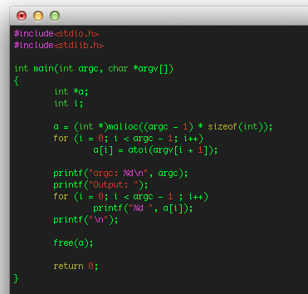
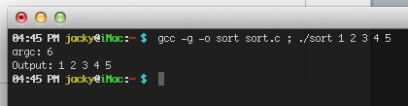
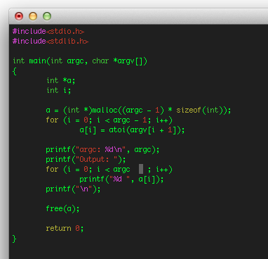
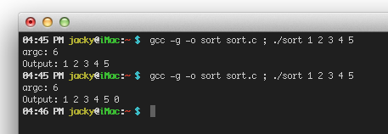
d
Note: argc in C/C++ counts Program_itself + parameters
i.e. if no parameter is given, argc is 1.
Wrong! Buffer overun error!

Slide 29
Fault Diagnosis
Cause is “Invoking shell_sort() with argc”
Proven by two experiments:
  Invoked with argc, the failure occurs;
  Invoked with argc - 1, it does not, fixed.
Side-effect of scientific debugging: we have a fix

Slide 30
Final Notes
The scientific method is tedious to apply, but it always works, because it is more scientific to apply!
So, if we have exhausted our own ideas to debug our programs but still failed, try it.
A key merit of the scientific method is that we are not only locating the bug, but also produce a code fix (i.e., a patch of the code to correct the program!)

